Slide 1
Validation Experiment
國立政治大學 資訊管理學系
蔡瑞煌 特聘教授

Slide 2
Algorithm development (Algorithm - Wikipedia)
Where we are now...
Typical steps in the development of algorithms:
Problem definition
Development of a model
Specification of the algorithm
Designing an algorithm
Checking the correctness of the algorithm
Analysis of algorithm
Implementation of algorithm
Program testing
Documentation preparation
2

Slide 3
Debug the code of new algorithm
Where we are now...
Cannot validate any learning algorithm through the mathematical proof.
Code the new algorithm first.
How can I do if the code is wrong or if the result of implementing the code is unsatisfied? ← Debug! Debug! And Debug!
First: Debug each block/module through printing out some information associated with the block/module.
Second: Debug the consistency amongst several consecutive blocks through printing out some data flow between these consecutive blocks.
Third: Debug the logic of the whole algorithm through printing out some results.

Slide 4
Fix the algorithm when you find the bug
Where we are now...
Debug each block/module through printing out some information regarding it. ← Fix the bugs of each block/module or replace it.
Debug the consistency amongst several consecutive blocks through printing out some information regarding the data flow of these consecutive blocks. ← Fix the inconsistency via fine-tuning or replacing some blocks.
Debug the logic of the whole algorithm through printing out some results. ← Fix the logic via fine-tuning some blocks or replacing them. This is the core of validating the new algorithm.

Slide 5
Validate the new algorithm
Validate the new algorithm through an AI application experiment with the AI application problem/data, the proposed algorithm, and the computation capability.
Check whether the corresponding learning process does display the proposed ideas/concepts. This is an AI fundamental research issue regarding the learning algorithm.
Check whether the proposed learning algorithm does lead to good performances in specific AI applications. This is an AI application research issue regarding the application performance.

Slide 6
The AI Application Problem
(bi_ReLU_sbo)
• Single Proton Emission Computed Tomography (SPECT)
heart diagnosis data set (Kurgan, et al., 2001; UCI Machine Learning)
• 267 instances (55 normal samples and 212 abnormal samples)
• 23 attributes
(x: 22 (binary) attributes,
y: 1 (binary) attribute)
Training data set | Amount of positive samples | 40
 | Amount of negative samples | 40
Testing data set | Amount of positive samples | 15
 | Amount of negative samples | 172
Total amount of samples |  | 267
• y: Binary (normal: 0, abnormal: 1)
• Randomly generate 20 sets of training and testing data.
• Positive: normal; Negative: abnormal
6

Slide 7

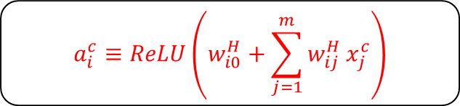



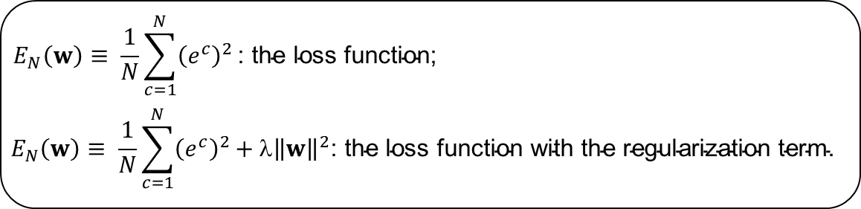
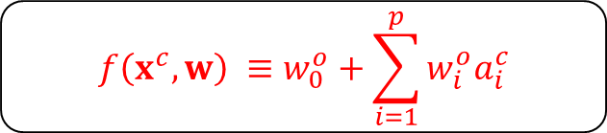
Forward operation
Hidden Layer
The hidden layer:
i
$$a_{i}^{c}≡\operatorname{ReLU}\left(w_{i0}^{H}+\sum_{j=1}^{m}{w_{ij}^{H}}x_{j}^{c}\right)$$
Input Layer
$$x_{1}$$
$$x_{2}$$
$$x_{3}$$
…
$$x_{m}$$
Output Layer
The output layer:
1
$$f\left(x^{c},w\right) ≡w_{0}^{o}+\sum_{i=1}^{p}{w_{i}^{o}a_{i}^{c}}$$
Hidden Layer
1
2
…
p
$$E_{N}\left(w\right)≡ \frac{1}{N}\sum_{c=1}^{N}{{\left(e^{c}\right)}^{2}}\text{: }\text{the} \text{loss} \text{function}\text{;}$$
$$E_{N}\left(w\right)≡ \frac{1}{N}\sum_{c=1}^{N}{{\left(e^{c}\right)}^{2}}\text{+ }\text{λ}{\left\|w\right\|}^{2}\text{: }\text{the} \text{loss} \text{function} \text{with} \text{the} \text{regularization} \text{term}\text{.}$$
7
Notes:
The Single-hidden layer Feedforward Neural Networks (SLFN) structure

Slide 8
The proposed learning algorithm
(in flowchart)
True
n ≥ N
False
Selecting
learning goal
False
Save w
True
Matching
A
n ++
Reorganizing
Cramming
Restore w
B
Initializing
8

Slide 9
The computation capability
Property | Tool
OS | Ubuntu 16.04.5 LTS
Programming Language | Python 3.6.5
TensorFlow Version | 1.9.0
IDE | Jupyter Notebook
GPU | NVIDIA Tesla K40c
RAM | DDR4 8G x 4
9

Slide 10
Objectives of the experiment
The experiment results should provide evidences for examining whether
the corresponding learning process does display the proposed ideas/concepts – the LTS module, the cramming module, and the reorganizing module can help cope with the encountered undesired attractors and alleviate the overfitting tendency.
the proposed learning algorithm does lead to good application performance – the proposed learning algorithm can have better accuracy than other tools in the literature and the total amount of training time is acceptable.
10

Slide 11
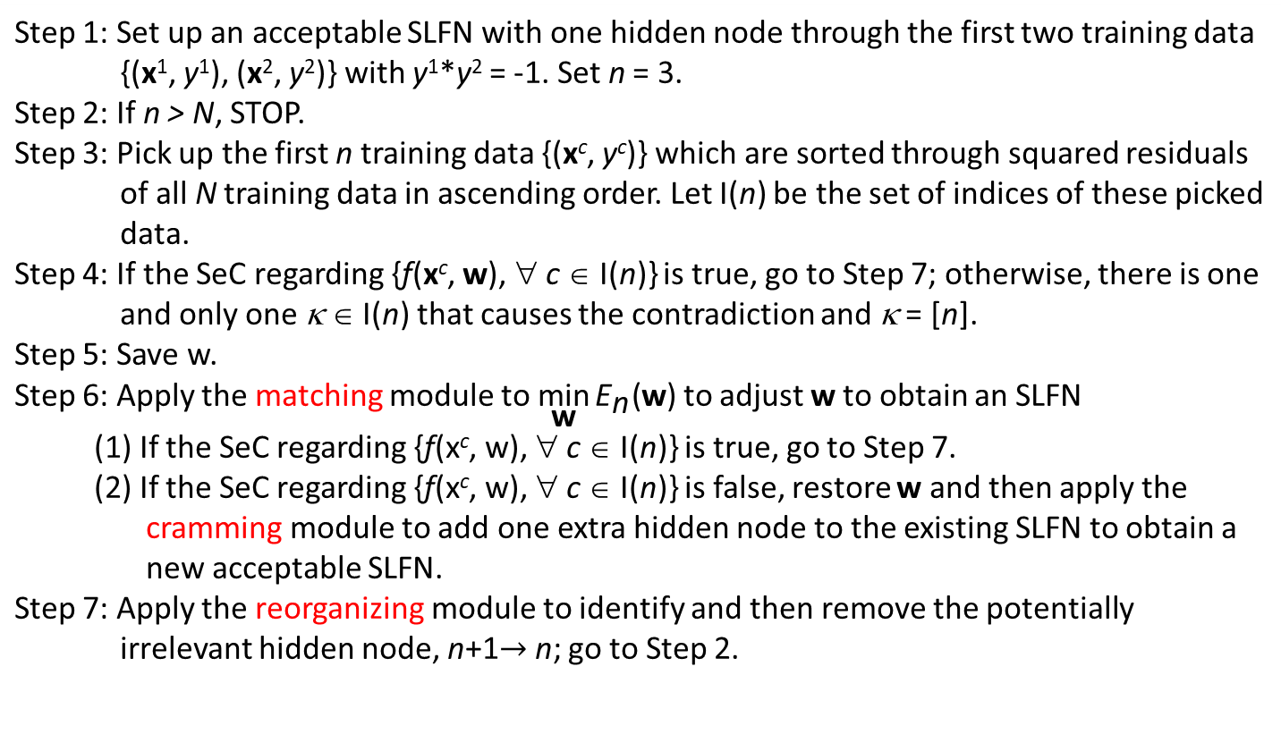
The proposed learning algorithm
(in Pseudocode)
Is the total amount of training time acceptable?
Step 1: Set up an acceptable SLFN with one hidden node through the first two training data {(x¹, y¹), (x², y²)} with y¹*y² = -1. Set n = 3. Step 2: If n > N, STOP. Step 3: Pick up the first n training data {(x^{c}, y^{c})} which are sorted through squared residuals of all N training data in ascending order. Let I(n) be the set of indices of these picked data. Step 4: If the SeC regarding {f(x^{c}, w), ∀ c ∈ I(n)} is true, go to Step 7; otherwise, there is one and only one κ ∈ I(n) that causes the contradiction and κ = [n]. Step 5: Save w. Step 6: Apply the matching module to $\underset{\text{w}}{\text{min}}{{\text{E}}_{\text{n}}\text{(}\text{w}\text{)}}$ to adjust w to obtain an SLFN (1) If the SeC regarding {f(x^{c}, w), ∀ c ∈ I(n)} is true, go to Step 7. (2) If the SeC regarding {f(x^{c}, w), ∀ c ∈ I(n)} is false, restore w and then apply the cramming module to add one extra hidden node to the existing SLFN to obtain a new acceptable SLFN. Step 7: Apply the reorganizing module to identify and then remove the potentially irrelevant hidden node, n+1$→$n; go to Step 2.
Percentages?
Is the LTS principle good for learning?
Success rate?
11

Slide 12
The process flow of new algorithm within the learning
Is the total amount of training time acceptable?
Is the LTS principle good for learning?
True
n ≥ N
False
Selecting
Percentages of taking blue, green, and red paths?
learning goal
False
Save w
True
A
Matching
n ++
Reorganizing
Cramming
Restore w
B
Initializing
Success rate?
12

Slide 13
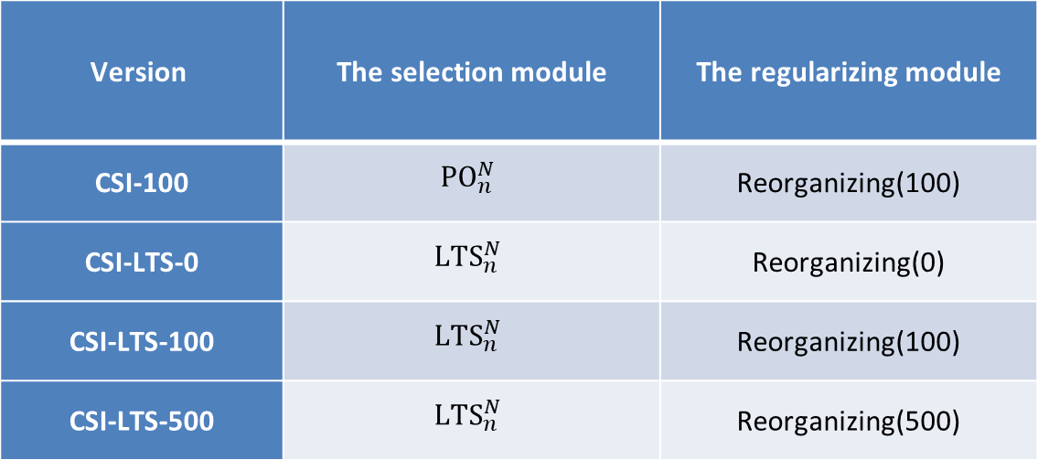
Four versions
For the validation purpose, there are four versions of the proposed learning algorithm.
Version | The selection module | The regularizing module
CSI-100 | $${PO}_{n}^{N}$$ | Reorganizing(100)
CSI-LTS-0 | $${LTS}_{n}^{N}$$ | Reorganizing(0)
CSI-LTS-100 | $${LTS}_{n}^{N}$$ | Reorganizing(100)
CSI-LTS-500 | $${LTS}_{n}^{N}$$ | Reorganizing(500)
13

Slide 14
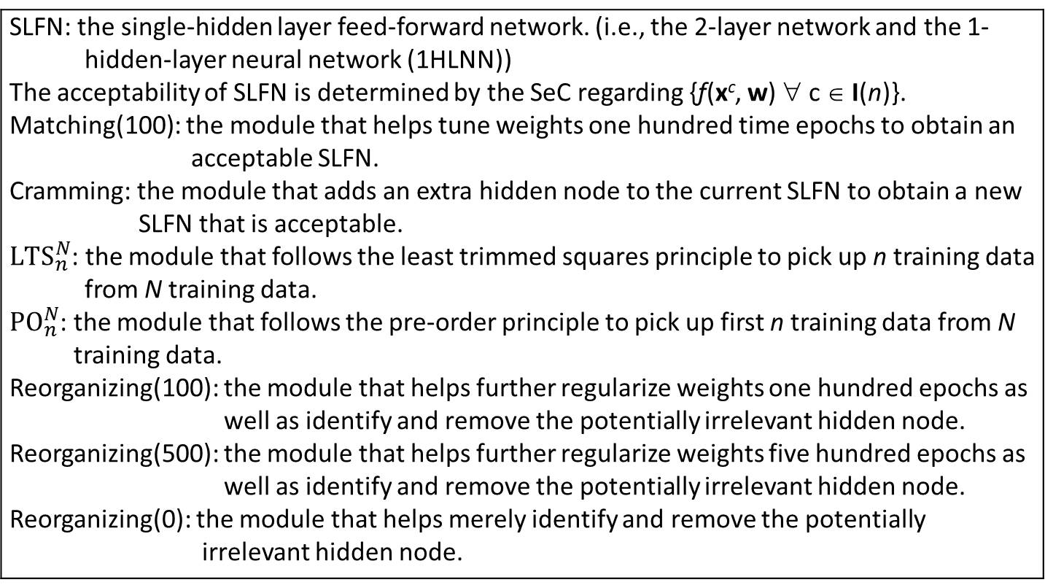
Notations
SLFN: the single-hidden layer feed-forward network. (i.e., the 2-layer network and the 1-hidden-layer neural network (1HLNN)) The acceptability of SLFN is determined by the SeC regarding {f(x^{c}, w) ∀ c ∈ I(n)}. Matching(100): the module that helps tune weights one hundred time epochs to obtain an acceptable SLFN. Cramming: the module that adds an extra hidden node to the current SLFN to obtain a new SLFN that is acceptable. ${LTS}_{n}^{N}$: the module that follows the least trimmed squares principle to pick up n training data from N training data. ${PO}_{n}^{N}$: the module that follows the pre-order principle to pick up first n training data from N training data. Reorganizing(100): the module that helps further regularize weights one hundred epochs as well as identify and remove the potentially irrelevant hidden node. Reorganizing(500): the module that helps further regularize weights five hundred epochs as well as identify and remove the potentially irrelevant hidden node. Reorganizing(0): the module that helps merely identify and remove the potentially irrelevant hidden node.
14

Slide 15
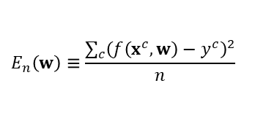
Matching(100)
$$E_{n}\left(w\right)≡\frac{\sum_{c}{{\left(f\left(x^{c},w\right)−y^{c}\right)}^{2}}}{n}$$
Hyperparameters:
100
Optimizer
Learning rate = 0.01
ε
i = 1
i++
forward
operation
False
i ≥ 100
SeC
backward operation
False
True
True
B
Unacceptable SLFN
Acceptable SLFN
A

Slide 16


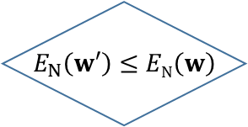
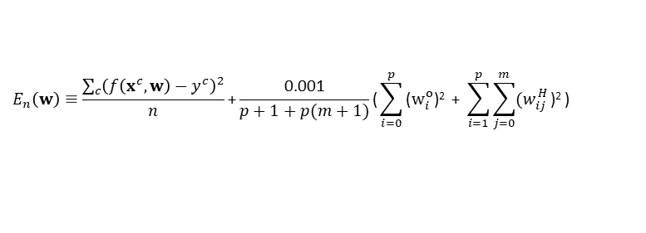

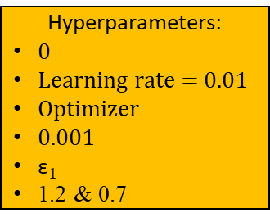
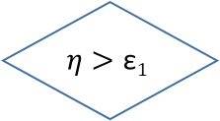

Regularizing(0)
An acceptable SLFN that accomplishes the learning goal
$$η$$
i = 1
$$E_{n}\left(w\right)≡\frac{\sum_{c}{{\left(f\left(x^{c},w\right)−y^{c}\right)}^{2}}}{n}\text{+}\frac{\text{0.001}}{p+1+p(m+1)}\text{(}\sum_{i=0}^{p}{\text{(}w_{i}^{o}\text{)}\text{2}}\text{ + }\sum_{i=1}^{p}{\sum_{j=0}^{m}{{(w}_{ij}^{H}}\text{)}\text{2}}\text{)}$$
An acceptable SLFN that has a preference on weights
True
i ≥ 0
False
Store w
Hyperparameters:
0
Learning rate = 0.01
Optimizer
0.001
$\text{ε}1$
1.2 & 0.7
backward operation to obtain $w′$
$w^{′}→w$ $$1.2 η→η$$
i+1 $→$ i
forward operation
Restore w
& $0.7η→η$
$$E_{N}\left(w′\right)≤EN\left(w\right)$$
SeC
True
True
False
False
True
$$η>\text{ε}1$$
An acceptable SLFN that has a preference on weights
False
Restore w

Slide 17
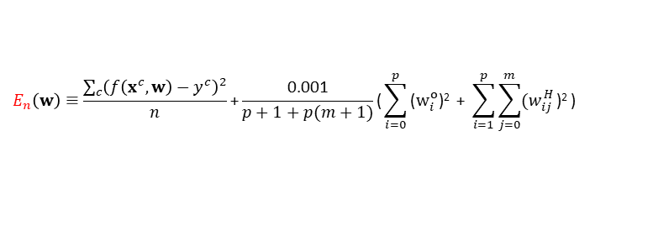
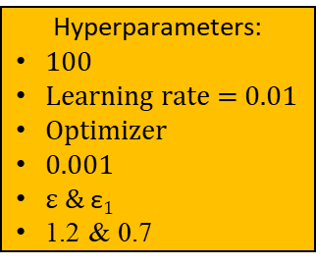
Regularizing(100)
An acceptable SLFN that accomplishes the learning goal
$$η$$
i = 1
$$E_{n}\left(w\right)≡\frac{\sum_{c}{{\left(f\left(x^{c},w\right)−y^{c}\right)}^{2}}}{n}\text{+}\frac{\text{0.001}}{p+1+p(m+1)}\text{(}\sum_{i=0}^{p}{\text{(}w_{i}^{o}\text{)}\text{2}}\text{ + }\sum_{i=1}^{p}{\sum_{j=0}^{m}{{(w}_{ij}^{H}}\text{)}\text{2}}\text{)}$$
An acceptable SLFN that has a preference on weights
True
i ≥ 100
False
Store w
Hyperparameters:
100
Learning rate = 0.01
Optimizer
0.001
ε & $\text{ε}1$
1.2 & 0.7
backward operation to obtain $w′$
$w^{′}→w$ $$1.2 η→η$$
i+1 $→$ i
forward operation
Restore w
& $0.7η→η$
$$E_{N}\left(w′\right)≤EN\left(w\right)$$
SeC
True
True
False
False
True
$$η>\text{ε}1$$
An acceptable SLFN that has a preference on weights
False
Restore w

Slide 18
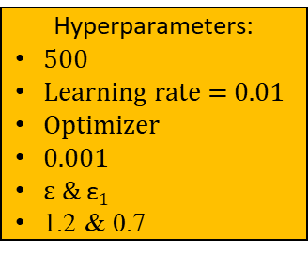
Regularizing(500)
An acceptable SLFN that accomplishes the learning goal
$$η$$
i = 1
$$E_{n}\left(w\right)≡\frac{\sum_{c}{{\left(f\left(x^{c},w\right)−y^{c}\right)}^{2}}}{n}\text{+}\frac{\text{0.001}}{p+1+p(m+1)}\text{(}\sum_{i=0}^{p}{\text{(}w_{i}^{o}\text{)}\text{2}}\text{ + }\sum_{i=1}^{p}{\sum_{j=0}^{m}{{(w}_{ij}^{H}}\text{)}\text{2}}\text{)}$$
An acceptable SLFN that has a preference on weights
True
i ≥ 500
False
Store w
Hyperparameters:
500
Learning rate = 0.01
Optimizer
0.001
ε & $\text{ε}1$
1.2 & 0.7
backward operation to obtain $w′$
$w^{′}→w$ $$1.2 η→η$$
i+1 $→$ i
forward operation
Restore w
& $0.7η→η$
$$E_{N}\left(w′\right)≤EN\left(w\right)$$
SeC
True
True
False
False
True
$$η>\text{ε}1$$
An acceptable SLFN that has a preference on weights
False
Restore w

Slide 19
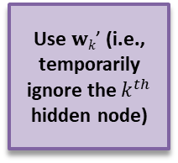
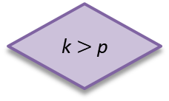
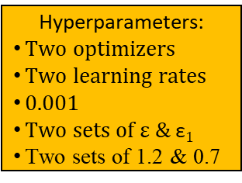
Reorganizing(0)
Hyperparameters:
Two optimizers
Two learning rates
0.001
Two sets of ε & $\text{ε}1$
Two sets of 1.2 & 0.7
The acceptability is SeC
Restore the network and w
k ++
p --
A
B
An acceptable SLFN
k $>$p
Regularizing(0)
Use $wk\text{’}$ (i.e., temporarily ignore the $k^{th}$ hidden node)
Matching(100)
k = 1
False
Store the network and w
True
An acceptable SLFN

Slide 20
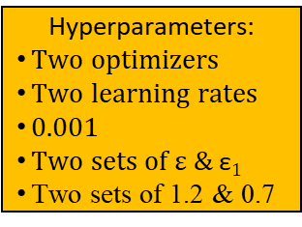
Reorganizing(100)
Hyperparameters:
Two optimizers
Two learning rates
0.001
Two sets of ε & $\text{ε}1$
Two sets of 1.2 & 0.7
The acceptability is SeC
Restore the network and w
k ++
p --
A
B
An acceptable SLFN
k $>$p
Regularizing(100)
Use $wk\text{’}$ (i.e., temporarily ignore the $k^{th}$ hidden node)
Matching(100)
k = 1
False
Store the network and w
True
An acceptable SLFN

Slide 21
Reorganizing(500)
Hyperparameters:
Two optimizers
Two learning rates
0.001
Two sets of ε & $\text{ε}1$
Two sets of 1.2 & 0.7
The acceptability is SeC
Restore the network and w
k ++
p --
A
B
An acceptable SLFN
k $>$p
Regularizing(500)
Use $wk\text{’}$ (i.e., temporarily ignore the $k^{th}$ hidden node)
Matching(100)
k = 1
False
Store the network and w
True
An acceptable SLFN

Slide 22

The proposed CSI-100
True
n ≥ N
False
$${PO}_{n}^{N}$$
SeC
False
Save w
True
Matching(100)
A
n ++
Reorganizing(100)
Cramming
Restore w
B
Initializing
22

Slide 23

The proposed CSI-LTS-0
True
n ≥ N
False
$${LTS}_{n}^{N}$$
SeC
False
Save w
True
Matching(100)
A
n ++
Reorganizing(0)
Cramming
Restore w
B
Initializing
23

Slide 24
The proposed CSI-LTS-100
True
n ≥ N
False
$${LTS}_{n}^{N}$$
SeC
False
Save w
True
Matching(100)
A
n ++
Reorganizing(100)
Cramming
Restore w
B
Initializing
24

Slide 25
The proposed CSI-LTS-500
True
n ≥ N
False
$${LTS}_{n}^{N}$$
SeC
False
Save w
True
Matching(100)
A
n ++
Reorganizing(500)
Cramming
Restore w
B
Initializing
25

Slide 26
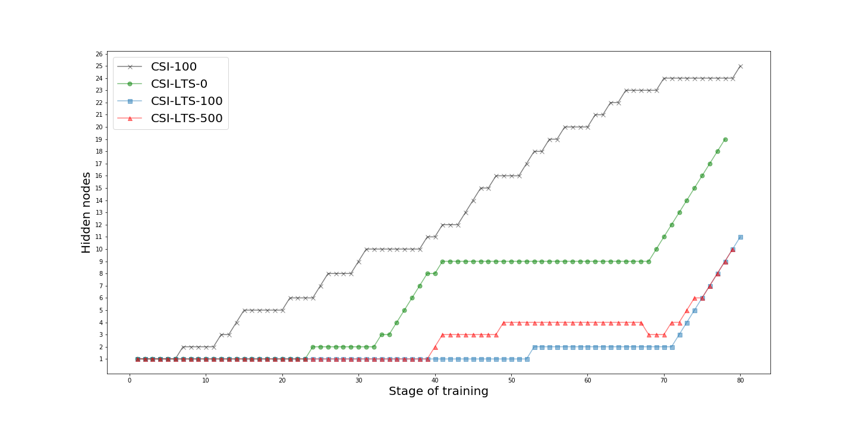
The evolution of total amount of adopted hidden nodes in the learning process of the 1st data set
As expected, there are cramming actions triggered frequently in the early stages of the learning process of CSI-100. In contrast, in the early stages of the learning process of CSI-LTS-100, the cramming module does not be triggered because of the LTS principle.
26

Slide 27
Total amount of adopted hidden nodes
CSI-100: from 4 hidden nodes to 25 hidden nodes.
CSI-LTS-0: from 3 hidden nodes to 30 hidden nodes.
CSI-LTS-100: from 6 hidden nodes to 12 hidden nodes.
CSI-LTS-500: from 5 hidden nodes to 15 hidden nodes.
Set No. | CSI-100 | CSI-LTS-0 | CSI-LTS-100 | CSI-LTS-500
1 | 25 | 19 | 11 | 10
2 | 16 | 5 | 7 | 14
3 | 16 | 11 | 11 | 7
4 | 7 | 24 | 7 | 10
5 | 21 | 26 | 11 | 11
6 | 10 | 22 | 11 | 9
7 | 11 | 25 | 13 | 7
8 | 19 | 12 | 10 | 9
9 | 25 | 10 | 6 | 11
10 | 4 | 5 | 11 | 8
11 | 13 | 3 | 7 | 11
12 | 15 | 12 | 9 | 11
13 | 17 | 23 | 10 | 15
14 | 7 | 22 | 12 | 12
15 | 16 | 9 | 11 | 10
16 | 8 | 21 | 9 | 13
17 | 8 | 23 | 8 | 13
18 | 12 | 9 | 12 | 7
19 | 10 | 14 | 8 | 5
20 | 17 | 30 | 7 | 11
Average | 13.85 | 16.25 | 9.55 | 10.20
Standard deviation | 5.9 | 8.1 | 2.06 | 2.6
The adoption of LTS in Step 3 and the regularizing module in Step 7 help reduce the total amount of adopted hidden nodes, in average.
In terms of the total amount of adopted hidden nodes, the average and standard deviation of CSI-LTS-100 are the smallest.

Slide 28
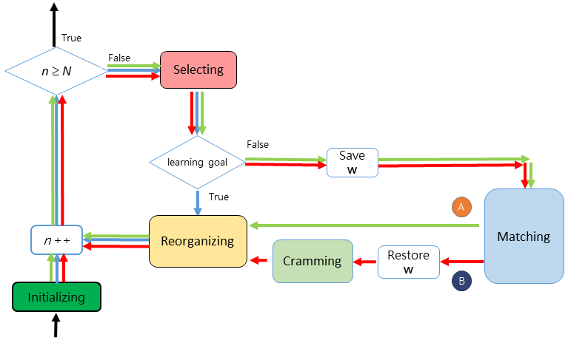
The percentages of Step 4, Step 6.1 and Step 6.2
To learn the new data, the proposed algorithm has one of the following three paths to get an acceptable SLFN:
Step 4: blue
Step 6.1: green
Step 6.2: red
28

Slide 29
The percentages of Step 4, Step 6.1 and Step 6.2
To learn the new data, the proposed algorithm has one of the following three paths to get an acceptable SLFN:
Step 4: The current SLFN is acceptable since the new data is acceptable.
Step 6.1: Use the matching module to get an acceptable SLFN.
Step 6.2: Use the cramming module to get an acceptable SLFN.
29

Slide 30
CSI-100
Set No. | Step 4 | Step 6.1 | Step 6.2
1 | 62.50% | 2.50% | 35.00%
2 | 73.75% | 3.75% | 22.50%
3 | 63.75% | 15.00% | 21.25%
4 | 71.25% | 18.75% | 10.00%
5 | 58.75% | 11.25% | 30.00%
6 | 60.00% | 25.00% | 15.00%
7 | 71.25% | 12.50% | 16.25%
8 | 61.25% | 6.25% | 32.50%
9 | 60.00% | 2.50% | 37.50%
10 | 67.50% | 26.25% | 6.25%
11 | 72.50% | 7.50% | 20.00%
12 | 68.75% | 8.75% | 22.50%
13 | 68.75% | 3.75% | 27.50%
14 | 73.75% | 15.00% | 11.25%
15 | 68.75% | 5.00% | 26.25%
16 | 70.00% | 16.25% | 13.75%
17 | 78.75% | 10.00% | 11.25%
18 | 63.75% | 20.00% | 16.25%
19 | 78.75% | 7.50% | 13.75%
20 | 61.25% | 5.00% | 33.75%
Average | 67.75% | 11.13% | 21.13%
Standard deviation | 6.13% | 7.28% | 9.27%
There are approximately 67.75% of training data that are acceptable and thus the current SLFN is acceptable, 11.13% of training data are learned by using the matching module and 21.13% of training data are learned by using the cramming module.

Slide 31
CSI-LTS-0
Set No. | Step 4 | Step 6.1 | Step 6.2
1 | 61.25% | 13.75% | 25.00%
2 | 62.50% | 30.00% | 7.50%
3 | 60.00% | 23.75% | 16.25%
4 | 63.75% | 5.00% | 31.25%
5 | 52.50% | 12.50% | 35.00%
6 | 62.50% | 7.50% | 30.00%
7 | 61.25% | 5.00% | 33.75%
8 | 71.25% | 10.00% | 18.75%
9 | 65.00% | 21.25% | 13.75%
10 | 72.50% | 17.50% | 10.00%
11 | 83.75% | 11.25% | 5.00%
12 | 62.50% | 21.25% | 16.25%
13 | 58.75% | 11.25% | 30.00%
14 | 53.75% | 15.00% | 31.25%
15 | 60.00% | 27.50% | 12.50%
16 | 61.25% | 11.25% | 27.50%
17 | 57.50% | 8.75% | 33.75%
18 | 73.75% | 13.75% | 12.50%
19 | 65.00% | 16.25% | 18.75%
20 | 57.50% | 3.75% | 38.75%
Average | 63.31% | 14.31% | 22.38%
Standard deviation | 7.30% | 7.37% | 10.36%
There are approximately 63.31% of training data that are acceptable and thus the current SLFN is acceptable, 14.31% of training data are learned by using the matching module and 22.38% of training data are learned by using the cramming module.

Slide 32
CSI-LTS-100
Set No. | Step 4 | Step 6.1 | Step 6.2
1 | 71.25% | 11.25% | 17.50%
2 | 73.75% | 13.75% | 12.50%
3 | 68.75% | 15% | 16.25%
4 | 72.5% | 11.25% | 16.25%
5 | 72.5% | 10% | 17.50%
6 | 68.75% | 13.75% | 17.50%
7 | 71.25% | 7.5% | 21.25%
8 | 70% | 13.75% | 16.25%
9 | 68.75% | 17.5% | 13.75%
10 | 75% | 5% | 20.00%
11 | 72.5% | 13.75% | 13.75%
12 | 77.5% | 8.75% | 13.75%
13 | 71.25% | 11.25% | 17.50%
14 | 65% | 18.75% | 16.25%
15 | 66.25% | 16.25% | 17.50%
16 | 68.75% | 15% | 16.25%
17 | 72.5% | 16.25% | 11.25%
18 | 63.75% | 20% | 16.25%
19 | 76.25% | 7.5% | 16.25%
20 | 71.25% | 10% | 18.75%
Average | 70.88% | 12.81% | 16.31%
Standard deviation | 3.51% | 3.99% | 2.42%
There are approximately 70.88% of training data that are acceptable and thus the current SLFN is acceptable, 12.81% of training data are learned by using the matching module and 16.31% of training data are learned by using the cramming module.

Slide 33
CSI-LTS-500
Set No. | Step 4 | Step 6.1 | Step 6.2
1 | 72.50% | 11.25% | 16.25%
2 | 67.50% | 11.25% | 21.25%
3 | 67.50% | 21.25% | 11.25%
4 | 77.50% | 5.00% | 17.50%
5 | 75.00% | 8.75% | 16.25%
6 | 67.50% | 17.50% | 15.00%
7 | 67.50% | 18.75% | 13.75%
8 | 63.75% | 18.75% | 17.50%
9 | 68.75% | 13.75% | 17.50%
10 | 75.00% | 11.25% | 13.75%
11 | 50.00% | 33.75% | 16.25%
12 | 72.50% | 12.50% | 15.00%
13 | 75.00% | 3.75% | 21.25%
14 | 65.00% | 18.75% | 16.25%
15 | 67.50% | 16.25% | 16.25%
16 | 73.75% | 5.00% | 21.25%
17 | 65.00% | 16.25% | 18.75%
18 | 62.50% | 27.50% | 10.00%
19 | 58.75% | 33.75% | 7.50%
20 | 76.25% | 7.50% | 16.25%
Average | 68.44% | 15.63% | 15.94%
Standard deviation | 6.70% | 8.63% | 3.56%
There are approximately 68.44% of training data that are acceptable and thus the current SLFN is acceptable, 15.63% of training data are learned by using the matching module and 15.94% of training data are learned by using the cramming module.

Slide 34
The occurrence percentages of Step 4
CSI-100: from 58.75% to 78.75%.
CSI-LTS-0: from 52.50% to 83.75%.
CSI-LTS-100: from 63.75% to 76.25%.
CSI-LTS-500: from 50.00% to 77.50%.
Set No. | CSI-100 | CSI-LTS-0 | CSI-LTS-100 | CSI-LTS-500
1 | 62.50% | 61.25% | 71.25% | 72.50%
2 | 73.75% | 62.50% | 73.75% | 67.50%
3 | 63.75% | 60.00% | 68.75% | 67.50%
4 | 71.25% | 63.75% | 72.50% | 77.50%
5 | 58.75% | 52.50% | 72.50% | 75.00%
6 | 60.00% | 62.50% | 68.75% | 67.50%
7 | 71.25% | 61.25% | 71.25% | 67.50%
8 | 61.25% | 71.25% | 70.00% | 63.75%
9 | 60.00% | 65.00% | 68.75% | 68.75%
10 | 67.50% | 72.50% | 75.00% | 75.00%
11 | 72.50% | 83.75% | 72.50% | 50.00%
12 | 68.75% | 62.50% | 77.50% | 72.50%
13 | 68.75% | 58.75% | 71.25% | 75.00%
14 | 73.75% | 53.75% | 65.00% | 65.00%
15 | 68.75% | 60.00% | 66.25% | 67.50%
16 | 70.00% | 61.25% | 68.75% | 73.75%
17 | 78.75% | 57.50% | 72.50% | 65.00%
18 | 63.75% | 73.75% | 63.75% | 62.50%
19 | 78.75% | 65.00% | 76.25% | 58.75%
20 | 61.25% | 57.50% | 71.25% | 76.25%
Average | 67.75% | 63.31% | 70.88% | 68.44%
Standard deviation | 6.13% | 7.30% | 3.51% | 6.70%
The average occurrence percentage of Step 4 over these four versions is the 67.59% and the standard deviation is 7%.
In terms of the occurrence percentage, the average of CSI-LTS-100 is the largest and the standard deviation of CSI-LTS-100 is the smallest.

Slide 35
The occurrence percentages of Step 6.1
CSI-100: from 2.50% to 26.25%.
CSI-LTS-0: from 3.75% to 30.00%.
CSI-LTS-100: from 5.00% to 20.00%.
CSI-LTS-500: from 3.75% to 33.75%.
Set No. | CSI-100 | CSI-LTS-0 | CSI-LTS-100 | CSI-LTS-500
1 | 2.50% | 13.75% | 11.25% | 11.25%
2 | 3.75% | 30.00% | 13.75% | 11.25%
3 | 15.00% | 23.75% | 15.00% | 21.25%
4 | 18.75% | 5.00% | 11.25% | 5.00%
5 | 11.25% | 12.50% | 10.00% | 8.75%
6 | 25.00% | 7.50% | 13.75% | 17.50%
7 | 12.50% | 5.00% | 7.50% | 18.75%
8 | 6.25% | 10.00% | 13.75% | 18.75%
9 | 2.50% | 21.25% | 17.50% | 13.75%
10 | 26.25% | 17.50% | 5.00% | 11.25%
11 | 7.50% | 11.25% | 13.75% | 33.75%
12 | 8.75% | 21.25% | 8.75% | 12.50%
13 | 3.75% | 11.25% | 11.25% | 3.75%
14 | 15.00% | 15.00% | 18.75% | 18.75%
15 | 5.00% | 27.50% | 16.25% | 16.25%
16 | 16.25% | 11.25% | 15.00% | 5.00%
17 | 10.00% | 8.75% | 16.25% | 16.25%
18 | 20.00% | 13.75% | 20.00% | 27.50%
19 | 7.50% | 16.25% | 7.50% | 33.75%
20 | 5.00% | 3.75% | 10.00% | 7.50%
Average | 11.13% | 14.31% | 12.81% | 15.63%
Standard deviation | 7.28% | 7.37% | 3.99% | 8.63%
The average occurrence percentage of Step 6.1 over these four versions is the 13.47% and the standard deviation is 7%.
In terms of the occurrence percentage, the average of CSI-LTS-500 is the largest and the standard deviation of CSI-LTS-100 is the smallest.

Slide 36
The occurrence percentages of Step 6.2
CSI-100: from 6.25% to 37.50%.
CSI-LTS-0: from 7.50% to 38.75%.
CSI-LTS-100: from 11.25% to 20.00%.
CSI-LTS-500: from 7.50% to 21.25%.
Set No. | CSI-100 | CSI-LTS-0 | CSI-LTS-100 | CSI-LTS-500
1 | 35.00% | 25.00% | 17.50% | 16.25%
2 | 22.50% | 7.50% | 12.50% | 21.25%
3 | 21.25% | 16.25% | 16.25% | 11.25%
4 | 10.00% | 31.25% | 16.25% | 17.50%
5 | 30.00% | 35.00% | 17.50% | 16.25%
6 | 15.00% | 30.00% | 17.50% | 15.00%
7 | 16.25% | 33.75% | 21.25% | 13.75%
8 | 32.50% | 18.75% | 16.25% | 17.50%
9 | 37.50% | 13.75% | 13.75% | 17.50%
10 | 6.25% | 10.00% | 20.00% | 13.75%
11 | 20.00% | 5.00% | 13.75% | 16.25%
12 | 22.50% | 16.25% | 13.75% | 15.00%
13 | 27.50% | 30.00% | 17.50% | 21.25%
14 | 11.25% | 31.25% | 16.25% | 16.25%
15 | 26.25% | 12.50% | 17.50% | 16.25%
16 | 13.75% | 27.50% | 16.25% | 21.25%
17 | 11.25% | 33.75% | 11.25% | 18.75%
18 | 16.25% | 12.50% | 16.25% | 10.00%
19 | 13.75% | 18.75% | 16.25% | 7.50%
20 | 33.75% | 38.75% | 18.75% | 16.25%
Average | 21.13% | 22.38% | 16.31% | 15.94%
Standard deviation | 9.27% | 10.36% | 2.42% | 3.56%
The average occurrence percentage of Step 6.2 over these four versions is the 18.94% and the standard deviation is 8%.
In terms of the occurrence percentage, the average of CSI-LTS-0 is the largest and the standard deviation of CSI-LTS-100 is the smallest.

Slide 37
Total amount of cramming occurrences
CSI-100: from 3 occurrences to 28 occurrences.
CSI-LTS-0: from 2 occurrences to 29 occurrences.
CSI-LTS-100: from 7 occurrences to 14 occurrences.
CSI-LTS-500: from 4 occurrences to 15 occurrences.
Set No. | CSI-100 | CSI-LTS-0 | CSI-LTS-100 | CSI-LTS-500
1 | 26 | 18 | 12 | 11
2 | 16 | 4 | 8 | 15
3 | 15 | 11 | 11 | 7
4 | 6 | 23 | 11 | 12
5 | 22 | 26 | 12 | 11
6 | 10 | 22 | 12 | 10
7 | 11 | 25 | 15 | 9
8 | 24 | 13 | 11 | 12
9 | 28 | 9 | 9 | 12
10 | 3 | 6 | 14 | 9
11 | 14 | 2 | 9 | 11
12 | 16 | 11 | 9 | 10
13 | 20 | 22 | 12 | 15
14 | 7 | 23 | 11 | 11
15 | 19 | 8 | 12 | 11
16 | 9 | 20 | 11 | 15
17 | 7 | 25 | 7 | 13
18 | 11 | 8 | 11 | 6
19 | 9 | 13 | 11 | 4
20 | 25 | 29 | 13 | 11
Average | 14.90 | 15.9 | 11.05 | 10.75
Standard deviation | 7.4 | 8.3 | 1.93 | 2.8
The adoption of LTS in Step 3 and the regularizing module in Step 7 help reduce the total amount of cramming occurrences, in average.
In terms of the total amount of cramming occurrences, the average of CSI-LTS-500 is the smallest, while the standard deviation of CSI-LTS-100 is the smallest.

Slide 38
The success rates of regularizing effort and reorganizing effort
In the proposed algorithm, Step 7 with merely the regularizing effort (Step 7i) and Step 7 with the reorganizing effort might help prune hidden nodes.
MS: the integration occurrences due to merely the regularizing effort
BSI: the integration occurrences due to the reorganizing effort.
38

Slide 39
The integration occurrences regarding each data set.
Set No. | CSI-100 |  | CSI-LTS-0 |  | CSI-LTS-100 |  | CSI-LTS-500
 | MS | BSI | MS | BSI | MS | BSI | MS | BSI
1 | 2 | 0 | 0 | 0 | 2 | 0 | 2 | 0
2 | 1 | 0 | 0 | 0 | 2 | 0 | 2 | 0
3 | 0 | 0 | 1 | 0 | 1 | 0 | 1 | 0
4 | 0 | 0 | 0 | 0 | 5 | 0 | 3 | 0
5 | 2 | 0 | 1 | 0 | 2 | 0 | 1 | 0
6 | 1 | 0 | 1 | 0 | 2 | 0 | 2 | 0
7 | 1 | 0 | 1 | 0 | 3 | 0 | 3 | 0
8 | 6 | 0 | 2 | 0 | 2 | 0 | 4 | 0
9 | 4 | 0 | 0 | 0 | 4 | 0 | 2 | 0
10 | 0 | 0 | 2 | 0 | 4 | 0 | 2 | 0
11 | 2 | 0 | 0 | 0 | 3 | 0 | 1 | 0
12 | 2 | 0 | 0 | 0 | 1 | 0 | 0 | 0
13 | 4 | 0 | 0 | 0 | 3 | 0 | 1 | 0
14 | 1 | 0 | 2 | 0 | 0 | 0 | 0 | 0
15 | 4 | 0 | 0 | 0 | 2 | 0 | 2 | 0
16 | 2 | 0 | 0 | 0 | 3 | 0 | 2 | 1
17 | 0 | 0 | 3 | 0 | 0 | 0 | 1 | 0
18 | 0 | 0 | 0 | 0 | 0 | 0 | 0 | 0
19 | 0 | 0 | 0 | 0 | 4 | 0 | 0 | 0
20 | 0 | 0 | 0 | 0 | 7 | 0 | 1 | 0
Average | 1.60 | 0 | 0.65 | 0 | 2.5 | 0 | 1.50 | 0.05
Standard Deviation | 1.73 | 0 | 0.93 | 0 | 1.76 | 0 | 1.10 | 0.22

Slide 40
The success rates of regularizing effort and reorganizing effort
The experiment observations show that more than one hidden nodes may be pruned within a reorganizing occurrence.
40

Slide 41
Total amount of hidden nodes that had been pruned within the learning process
The percentage of the reorganizing module doesn’t work
CSI-100: six out of twenty trials.
CSI-LTS-0: twelve out of twenty trials.
CSI-LTS-100: three out of twenty trials.
CSI-LTS-500: four out of twenty trials.
Set No. | CSI-100 | CSI-LTS-0 | CSI-LTS-100 | CSI-LTS-500
1 | 2 | 0 | 2 | 2
2 | 1 | 0 | 2 | 2
3 | 0 | 1 | 1 | 1
4 | 0 | 0 | 5 | 3
5 | 2 | 1 | 2 | 1
6 | 1 | 1 | 2 | 2
7 | 1 | 1 | 3 | 3
8 | 6 | 2 | 2 | 4
9 | 4 | 0 | 4 | 2
10 | 0 | 2 | 4 | 2
11 | 2 | 0 | 3 | 1
12 | 2 | 0 | 1 | 0
13 | 4 | 0 | 3 | 1
14 | 1 | 2 | 0 | 0
15 | 4 | 0 | 2 | 2
16 | 2 | 0 | 3 | 3
17 | 0 | 3 | 0 | 1
18 | 0 | 0 | 0 | 0
19 | 0 | 0 | 4 | 0
20 | 9 | 0 | 7 | 1
Average | 2.05 | 0.65 | 2.50 | 1.55
Standard deviation | 2.4 | 0.9 | 1.76 | 1.1
The average amount of hidden nodes that had been pruned over these four versions is the 1.69 and the standard deviation is 1.75.
In terms of the amount of integrations, the average of CSI-LTS-100 is the largest, while the standard deviation of CSI-LTS-0 is the smallest.

Slide 42
In ANN, this means more hidden nodes.
In statistics, overfitting is "the production of an analysis that corresponds too closely or exactly to a particular set of data, and may therefore fail to fit additional data or predict future observations reliably.“
An overfitted model is a statistical model that contains more parameters than can be justified by the data -- Everitt B.S., Skrondal A. (2010), Cambridge Dictionary of Statistics, Cambridge University Press.
whether the proposed learning algorithm can help cope with the encountered undesired attractors and alleviate the overfitting tendency
42

Slide 43
Total amount of adopted hidden nodes & the accuracy
Set No. | CSI-100 |  | CSI-LTS-0 |  | CSI-LTS-100 |  | CSI-LTS-500
1 | 25 | 0.417 | 19 | 0.545 | 11 | 0.604 | 10 | 0.626
2 | 16 | 0.358 | 5 | 0.674 | 7 | 0.572 | 14 | 0.524
3 | 16 | 0.342 | 11 | 0.615 | 11 | 0.663 | 7 | 0.722
4 | 7 | 0.695 | 24 | 0.594 | 7 | 0.701 | 10 | 0.636
5 | 21 | 0.321 | 26 | 0.492 | 11 | 0.610 | 11 | 0.684
6 | 10 | 0.701 | 22 | 0.775 | 11 | 0.647 | 9 | 0.706
7 | 11 | 0.813 | 25 | 0.631 | 13 | 0.572 | 7 | 0.765
8 | 19 | 0.321 | 12 | 0.706 | 10 | 0.551 | 9 | 0.599
9 | 25 | 0.246 | 10 | 0.615 | 6 | 0.717 | 11 | 0.690
10 | 4 | 0.711 | 5 | 0.620 | 11 | 0.781 | 8 | 0.535
11 | 13 | 0.417 | 3 | 0.674 | 7 | 0.733 | 11 | 0.786
12 | 15 | 0.428 | 12 | 0.455 | 9 | 0.711 | 11 | 0.578
13 | 17 | 0.299 | 23 | 0.471 | 10 | 0.743 | 15 | 0.690
14 | 7 | 0.706 | 22 | 0.588 | 12 | 0.701 | 12 | 0.663
15 | 16 | 0.444 | 9 | 0.684 | 11 | 0.556 | 10 | 0.588
16 | 8 | 0.717 | 21 | 0.561 | 9 | 0.663 | 13 | 0.690
17 | 8 | 0.674 | 23 | 0.578 | 8 | 0.684 | 13 | 0.551
18 | 12 | 0.380 | 9 | 0.722 | 12 | 0.652 | 7 | 0.631
19 | 10 | 0.754 | 14 | 0.695 | 8 | 0.679 | 5 | 0.711
20 | 17 | 0.316 | 30 | 0.374 | 7 | 0.711 | 11 | 0.684
Average | 13.85 | 0.503 | 16.25 | 0.603 | 9.55 | 0.663 | 10.20 | 0.653
Standard deviation | 5.9 | 0.2 | 8.1 | 0.1 | 2.06 | 0.07 | 2.6 | 0.1
It seems that the CSI-LTS-100 learning algorithm can help cope with the encountered undesired attractors and alleviate the overfitting tendency.
An overfitted model is a statistical model that contains more parameters than can be justified by the data -- Everitt B.S., Skrondal A. (2010), Cambridge Dictionary of Statistics, Cambridge University Press.
The CSI-LTS-100 version has a smallest average amount of adopted hidden nodes and a best average accuracy.
43

Slide 44
The best case over all training and testing samples
Generating diagnostic rules from cardiac SPECT data (Kurgan at al., 2001). This problem involved database containing cardiac SPECT heart images collected on 267 patients in stress and rest studies. CLIP3 algorithm was applied to generate diagnostic rules for overall diagnosis of the patient’s study, by using information of partial, in the predefined regions of the heart muscle, diagnoses. This is a two-classes problem: first class describes normal patients (55 examples), and second patients with coronary artery disease (212 examples). Three diagnostic rules were generated. The rules accuracy was 84%.
This study also examines an issue in the medical domain: whether the proposed learning algorithm can have better correctness of diagnoses than other methods in the current literature.
44

Slide 45
Training Time (Sec.)
CSI-100: from 332 seconds to 2290 seconds.
CSI-LTS-0: from 15 seconds to 2702 seconds.
CSI-LTS-100: from 26 seconds to 487 seconds.
CSI-LTS-500: from 19 seconds to 452 seconds.
Set No. | CSI-100 | CSI-LTS-0 | CSI-LTS-100 | CSI-LTS-500
1 | 1995 | 656 | 76 | 269
2 | 1243 | 17 | 464 | 452
3 | 944 | 62 | 48 | 61
4 | 622 | 1081 | 103 | 334
5 | 1733 | 1757 | 449 | 77
6 | 899 | 644 | 51 | 39
7 | 363 | 622 | 486 | 63
8 | 1459 | 78 | 98 | 67
9 | 1926 | 37 | 39 | 174
10 | 332 | 94 | 487 | 69
11 | 882 | 15 | 356 | 63
12 | 1255 | 576 | 38 | 423
13 | 1139 | 1612 | 315 | 214
14 | 766 | 827 | 58 | 62
15 | 1400 | 32 | 58 | 80
16 | 1391 | 145 | 139 | 226
17 | 2290 | 839 | 26 | 130
18 | 597 | 29 | 51 | 24
19 | 1717 | 266 | 410 | 19
20 | 2066 | 2702 | 270 | 152
Average | 1250.95 | 604.55 | 201.10 | 149.90
Standard deviation | 577.9 | 722.2 | 179.41 | 130.7
The adoption of LTS in Step 3 and the “longer” regularizing module in Step 7 is good for speeding up the learning process.
In terms of the training time, the average and standard deviation of CSI-LTS-500 are the smallest.

Slide 46
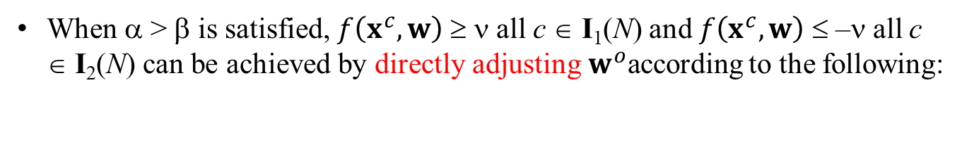



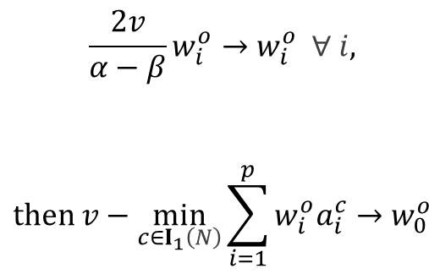
Inferencing mechanism
When α > β is satisfied, $f\left(x^{c},w\right)$ ≥ ν all c ∈ I₁(N) and $f\left(x^{c},w\right)$ ≤ –ν all c ∈ I₂(N) can be achieved by directly adjusting${ w}^{o}$according to the following:
$$\begin{aligned}\frac{2v}{α−β}w_{i}^{o}→w_{i}^{o} ∀ i, \\ \\ \\ then v−\min_{c∈I_{1}\left(N\right)}{\sum_{i=1}^{p}{w_{i}^{o}a_{i}^{c}}}→w_{0}^{o}\end{aligned}$$
The weight vector between the output node and the hidden layer
The threshold of the output node
 | Abnormal | Normal
Abnormal | TP | FP
Normal | FN | TN
Undecided | UP | UN
Actual
Predicted
$$normal (f ≤−v)$$
$abnormal (f ≥ v$)
o
o
o
x
x
o
x
x
$$f\left(x^{c},w\right)$$
Undecided (-ν ≤ f ≤ ν)
46

Slide 47
Experimental Design
• Accuracy measurement
Predictive Accuracy | (TP+TN) / (TP+TN+FP+FN+UP+UN)
Type 1 error rate | FN / (TP+FN+UP)
Type 2 error rate | FP / (FP+TN+UN)
Sensitivity | TP / (TP+FN+UP)
Specificity | TN / (TF+FP+UN)
Undecided rate | (UP+UN) / (TP+TN+FN+FP+UP+UN)
47

Slide 48
The accuracy
CSI-LTS-100: from 55.1% to 78.1%.
Set No. | CSI-100 | CSI-LTS-0 | CSI-LTS-100 | CSI-LTS-500
1 | 0.417 | 0.545 | 0.604 | 0.626
2 | 0.358 | 0.674 | 0.572 | 0.524
3 | 0.342 | 0.615 | 0.663 | 0.722
4 | 0.695 | 0.594 | 0.701 | 0.636
5 | 0.321 | 0.492 | 0.610 | 0.684
6 | 0.701 | 0.775 | 0.647 | 0.706
7 | 0.813 | 0.631 | 0.572 | 0.765
8 | 0.321 | 0.706 | 0.551 | 0.599
9 | 0.246 | 0.615 | 0.717 | 0.690
10 | 0.711 | 0.620 | 0.781 | 0.535
11 | 0.417 | 0.674 | 0.733 | 0.786
12 | 0.428 | 0.455 | 0.711 | 0.578
13 | 0.299 | 0.471 | 0.743 | 0.690
14 | 0.706 | 0.588 | 0.701 | 0.663
15 | 0.444 | 0.684 | 0.556 | 0.588
16 | 0.717 | 0.561 | 0.663 | 0.690
17 | 0.674 | 0.578 | 0.684 | 0.551
18 | 0.380 | 0.722 | 0.652 | 0.631
19 | 0.754 | 0.695 | 0.679 | 0.711
20 | 0.316 | 0.374 | 0.711 | 0.684
Average | 0.503 | 0.603 | 0.663 | 0.653
Standard deviation | 0.2 | 0.1 | 0.07 | 0.1
In terms of the accuracy, the average and standard deviation of CSI-LTS-100 are the best.

Slide 49
Recommend the CSI-LTS-100 over CSI-100, CSI-LTS-0 and CSI-LTS-500
49

Slide 50
The accuracy
CSI-LTS-100: from 55.1% to 78.1%.
Set No. | CSI-100 | CSI-LTS-0 | CSI-LTS-100 | CSI-LTS-500
1 | 0.417 | 0.545 | 0.604 | 0.626
2 | 0.358 | 0.674 | 0.572 | 0.524
3 | 0.342 | 0.615 | 0.663 | 0.722
4 | 0.695 | 0.594 | 0.701 | 0.636
5 | 0.321 | 0.492 | 0.610 | 0.684
6 | 0.701 | 0.775 | 0.647 | 0.706
7 | 0.813 | 0.631 | 0.572 | 0.765
8 | 0.321 | 0.706 | 0.551 | 0.599
9 | 0.246 | 0.615 | 0.717 | 0.690
10 | 0.711 | 0.620 | 0.781 | 0.535
11 | 0.417 | 0.674 | 0.733 | 0.786
12 | 0.428 | 0.455 | 0.711 | 0.578
13 | 0.299 | 0.471 | 0.743 | 0.690
14 | 0.706 | 0.588 | 0.701 | 0.663
15 | 0.444 | 0.684 | 0.556 | 0.588
16 | 0.717 | 0.561 | 0.663 | 0.690
17 | 0.674 | 0.578 | 0.684 | 0.551
18 | 0.380 | 0.722 | 0.652 | 0.631
19 | 0.754 | 0.695 | 0.679 | 0.711
20 | 0.316 | 0.374 | 0.711 | 0.684
Average | 0.503 | 0.603 | 0.663 | 0.653
Standard deviation | 0.2 | 0.1 | 0.07 | 0.1
Generating diagnostic rules from cardiac SPECT data (Kurgan at al., 2001). This problem involved database containing cardiac SPECT heart images collected on 267 patients in stress and rest studies. CLIP3 algorithm was applied to generate diagnostic rules for overall diagnosis of the patient’s study, by using information of partial, in the predefined regions of the heart muscle, diagnoses. This is a two-classes problem: first class describes normal patients (55 examples), and second patients with coronary artery disease (212 examples). Three diagnostic rules were generated. The rules accuracy was 84%.
The best case over all training and testing samples
[80 + (267-80)*66.3%]/267 = 76.4% ← in average
[80 + (267-80)*78.1%]/267 = 84.6% ← the best case

Slide 51
Hyper-parameter of Inferencing mechanism
Above are the results regarding v = 0.9.
Regarding v = 0, v = 0.8, v = 1.0, what the prediction performance will be?
Which one is the best v setting for obtaining a better accuracy?
51

